Slide 1
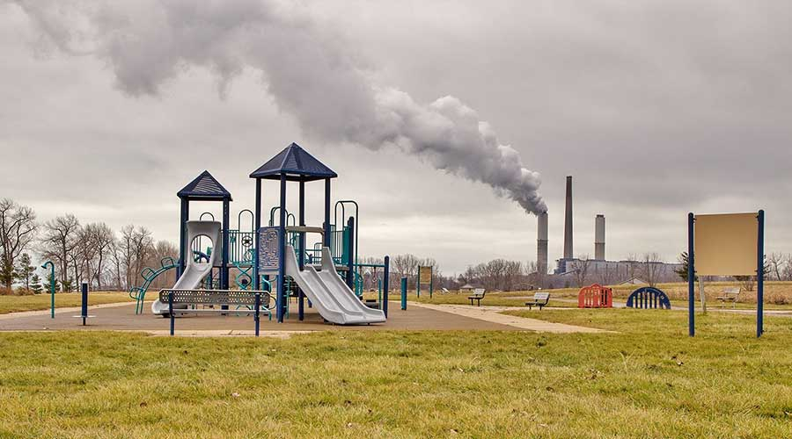
The Environmental Justice Thriving Communities Technical Assistance Centers Program (TC TAC)

Slide 2
Clean Air Act Section 138 Overview
$2.8 Billion for financial assistance:
$200 Million technical assistance for implementation
•All grants must benefit disadvantaged communities as defined by the EPA Administrator
Awards for grants eligible until September 30, 2026

Slide 3
Clean Air Act Section 138 Overview
•Grants activities generally including:
Pollution remediation and prevention
Workforce development tied to air pollution and greenhouse gas reductions
Climate adaptation and resiliency
Indoor air pollution, mitigating climate and health heat related issues
Facilitating engagement of disadvantaged communities in governmental processes
Provide Technical assistance to eligible grantees

Slide 4
Clean Air Act Section 138 Overview All grantee proposals must be implemented within 5 years Eligibility limited to: Community-based nonprofit organization Partnership of community-based nonprofit organizations Partnership between: Indian tribe, a local government, or an institution of higher education; and A community-based nonprofit organization

Slide 5
Grants and Technical Assistance
Assessment
Assessment Grants
Thriving Community Technical Assistance Centers (TCTACs)
Planning Grants
Technical Assistance
Pilots and Partnerships
EJ Collaborative Problem-Solving Grants (EJ-CPS)
EJ Government to Government Grants (EJ-G2G)
Implementation
E&CJ “Change Grants”
Evaluation and Reporting Technical Assistance
Planning & Project Development
Project Development Grants

Slide 6
Technical Assistance, Application, and Evaluation
Technical Assistance: Provide support application development and grant writing, reporting and bookkeeping, networking, marketing plans and communications, leadership development training for nonprofits, budget for outreach, and more
Application processes: Provide options and let organization self-determine, have different scales of funding for varied organizations, clear and transparent scoring, have line-item budgets, simplified checklists, and more
Evaluation and Reporting: Track immediate and long-term community benefits, track impacts by sectors, track cumulative impacts, track quality of community engagement and associated outcomes

Slide 7
TCTAC Programmatic Goals and Outcomes
Work across multiple sectors in one area/community
Be flexible on eligible entities and evaluate depth of connection to community*
Government and community work together to co-collaborate and co-create solutions
Prevent displacement
Community engagement in all projects, including clean energy
Wrap-around services and education included with infrastructure projects
Connect workforce to all projects
Multi-pronged approach centered on resilience, including:
Housing preservation
Clean air and water
Green jobs
Behavorial and physical health
Short-term and long-term solutions
Communities involved in all decisions and projects are community-designed
Benefits are clear to the community
Build community capacity, including project management and leadership development

Slide 8
Strategies and Projects that provide most benefits to disadvantaged communities
Integrate health outcomes and health access into all projects
Projects that are connected to a resource and/or resilience hub
Infrastructure projects that have programs connected to them
Invest in people as infrastructure (social workers, health workers)
Support the development of supportive networks
Make sure there is an integrated one-stop-shop for all projects

Slide 9
Strategies and Projects that provide most benefits to disadvantaged communities
Climate resilience: Addressing tree canopy, decarbonized heating and cooling centers, upgrading/retrofitting buildings and housing, alert warning systems, clean energy and community power systems, and more
Mitigating indoor and outdoor pollution: beauty salon certification and training, address causes that lead to pollution such as mold and artificial turf issues, replace gas appliances with electric, and more
Workforce development: Address barriers, including bad credit, lack of access to personal identification or bank accounts, provide reentry support for formerly incarcerated, and provide wrap-around services and a focus on life skills development.
Creating training programs related to:
Reducing energy use at home
Mitigating air and other pollution, and more

Slide 10
Facilitating engagement of disadvantaged communities in federal, state, and other public processes
Focus efforts on reducing disparities, including:
Poverty levels, education attainment, legal status, health disparities, geography, unemployment, environmental stressors, and social determinants of health
Prioritize:
Culturally-relevant outreach
Feedback loops, learned apathy, and transparency
Compensate residents for participation
Ensure proper access, including childcare and transportation
Active, ongoing outreach to most marginalized
Ensure:
Local leaders are educated and trained properly by the EPA
Language is equivalent to fourth grade reading level
Value lived experience

Slide 11
TCTAC Background
The formation of the EJ technical assistance centers, in partnership with the Department of Energy, is in direct response to feedback from communities and environmental justice leaders who have asked for readily accessible technical assistance to help with their long-term EJ goals and to help build their capacity to access federal and other resources. With this program there are 14 regionally and 3 nationally based TCTACs featuring over 160 partners to provide assistance benefiting communities throughout the US.
National TCTACS: Each will coordinate with the Regional TCTACs, develop national databases/clearinghouses, host TCTAC summits, etc.
Regional TCTACS: Each will provide direct support and TA to communities and stakeholders in specific regional/geographic area(s)

Slide 12
TCTAC Service Examples
Grant proposal writing and preparation assistance.
Managing federal grants (e.g., accounting, policies, controls)
Identify funding sources to apply for (federal, state, local, private)
Navigate SAM.gov and Grants.gov registration process and other portals related to grants.
Developing partnerships and coalitions to conduct outreach.

Slide 13
Region 3 TCTAC
National Wildlife Federation (NWF) (Project Lead & Co-facilitator)
The Center for Community Engagement, Environmental Justice, and Health (CEEJH), and the University of Maryland Environmental Finance Center (UMD EFC). (Co-facilitator)
Region 3 Partners
Centro De Apoyo Familiar (CAF) (VA)
South Baltimore Community Land Trust (MD)
Overbrook Environmental Education Center (PA)
Sussex Health & Environmental Network (DE)
Sentinels of Eastern Shore Health (MD), and
Empower DC.
Morgan State University (MD) will serve as the primary HBCU Hub.
West Virginia State University (VA) will act as a hybrid HBCU and community Hub.

Slide 14
To inquire about technical assistance or to volunteer as a Region 3 service provider:
Please call:
(202) 792-5350 or 1-800-757-1405
Website:
https://www.nwf.org/Our-Work/Environmental-Justice/Region-3-TCTAC
Intake Form: https://airtable.com/appZGWGjVj5Q6UGWc/paghQkRVxCrKUI3nq/form
To Subscribe to the mailing list: http://eepurl.com/iDtc16

Slide 15
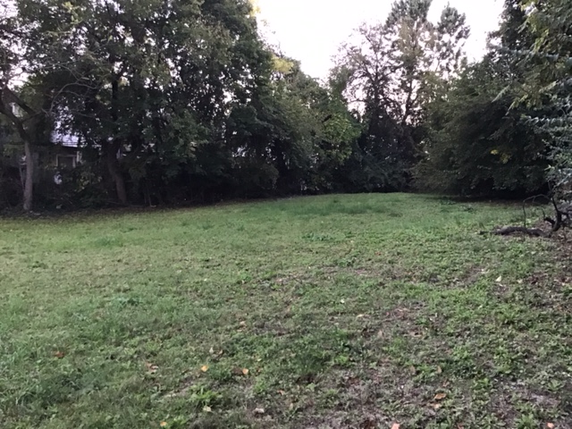
Overbrook Environmental Education Center
6134 Lancaster Avenue
Philadelphia, PA 19151
www.overbrookcenter.org
215.879-7770

